Slide 1
Introduction to Sociology-1st year
Spring 2013
Thomas Dollé
thomas.dolle@sciences-po.org
Office Hours: 12h15-13h15, on Thursdays.
Tel number: +33 6 23 74 29 15 (emergency)

Slide 2
Aims of the course
To acquire a sociological culture
To learn how evidence is made in sociology
To understand the core sociological concepts
To make a practical use of your knowledge

Slide 3
Lecture/Seminars
The weekly lecture will serve as an introduction to the main theoretical perspectives on a given topic. It will cover major substantive areas of sociological inquiry (culture, norms and deviance, social movements, hierarchies and stratification, power and inequalities, state and/in society, social organization of the economy).
the seminar, a hands-on approach, will provide you with the opportunity to grapple with both texts and methods.

Slide 4
How will you be graded?
5 types of required written assignments
A grade of class participation

Slide 5
During Class : 64%
Weekly quiz on the “discussion” text: 8%
Class participation (+ in-class exercises): 8%
Oral presentation of a selected text: 16% (2/3 of this grade will be for the actual presentation, 1/3 for the organization of the discussion)
Mid-term exam/“galop”: 16%
Book review (1500 to 2500 words, due the 28th of March): 16%

Slide 6
Final Exam: 36%
2 different types of exercises:
An analysis of documents.
A short essay on one question (to be chosen out of a few) directly linked to the lecture.

Slide 7
Attendance, Academic Honesty and Plagiarism
Class attendance is mandatory for the discussion sections, and highly recommended for the lectures.
All work submitted is clearly understood to be your own
All citations should be put between quotes.
all take-home papers and memos will be scanned through by an anti-plagiarism, software. (e-mail me your in-class presentations on Wednesdays)
Arrive on time, otherwise: 0 and reported late. Late 2 times = one absence.
3 absences: you fail.

Slide 8
Last but not least
The use of laptop and – of course – cell phones is absolutely prohibited in this course.

Slide 9
Consequences of not having a computer in class
You have to buy the printed copies of the texts. (or you can print your own texts).
Where?

Slide 10
Organization of a Session
Each session:
A ten-minute presentation
A general discussion, involving the entire class: students appointed to organize this debate
On the oral presentation:
Group of 2 or 3 people, duration: around 10 minutes (bet. 9-12)
A well-defined general question
Base for the following discussion
NOT a text summary
Main focus points: author, thesis, methodology, concepts, results.

Slide 11
Oral Presentation-2
Outline: introduction - 2/3 structured parts – conclusion
Grades:
General organization, outline and clarity: 4
General understanding of the text, presentation of the main ideas and concepts: 4
Presentation and discussion of the method: 4
Quality of the arguments and of the discussion of the results (including a general question at the beginning (“problématique”)): 5
Share of speaking time: 2
Respect of the time limit: 1

Slide 12
Class Discussion
Before the class: prepare some general questions, from the text. You might have to lead the debate.
During the presentation: prepare at least one question on the presentation.
I choose the students in charge of the discussion AFTER the presentation.
The students will then lead an active discussion with the rest of the group.

Slide 13
Class Discussion-2
Grades:
Quality of the question(s) asked about the presentation: 7
Quality of the questions asked to the audience, capacity to arouse its interest and to spark off a real debate: 11
General organization and control of the debate: 2

Slide 14
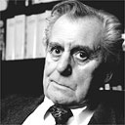
The Book Review (16% of your in-class grade)
HOGGART Richard, 2009 (1957), The Uses of Literacy: Aspects of Working Class Life, Penguin Books.

Slide 15
HOGGART Richard, 2009 (1957), The Uses of Literacy: Aspects of Working Class Life, Penguin Books.
“When a society becomes more affluent, does it lose other values? Do the media coerce us into a world of the superficial and the material - or can they be a force for good? When Richard Hoggart asked these questions in his 1957 book The Uses of Literacy, Britain was undergoing huge social change (…). Hoggart gives an insight into the close-knit values of Northern England's vanishing working-class communities, and weaves this together with his views on the arrival of a new, homogenous 'mass' US-influenced culture.” (Back cover of the book)

Slide 16
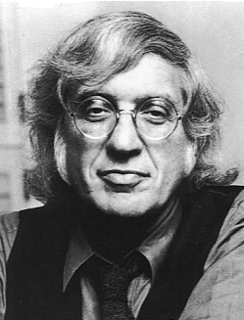
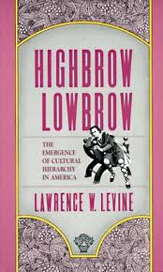
LEVINE Lawrence W., 1988, Highbrow/Lowbrow. The Emergence of Cultural Hierarchy in America, Harvard University Press.

Slide 17
LEVINE Lawrence W., 1988, Highbrow/Lowbrow. The Emergence of Cultural Hierarchy in America, Harvard University Press.
“In this unusually wide-ranging study, spanning more than a century and covering such diverse forms of expressive culture as Shakespeare, Central Park, symphonies, jazz, art museums, the Marx Brothers, opera, and vaudeville, a leading cultural historian demonstrates how variable and dynamic cultural boundaries have been and how fragile and recent the cultural categories we have learned to accept as natural and eternal are.” (Back cover of the book)

Slide 18
FARMER Paul, 2006 (1992), AIDS and Accusation. Haiti and the Geography of Blame, University of California Press.

Slide 19
FARMER Paul, 2006 (1992), AIDS and Accusation. Haiti and the Geography of Blame, University of California Press.
“Does the scientific “theory” that HIV came to North America from Haiti stem from underlying attitudes of racism and ethnocentrism in the United States rather than from hard evidence? Award-winning author and anthropologist-physician Paul Farmer answers with this, the first full-length ethnographic study of AIDS in a poor society.” (Back cover of the book)

Slide 20
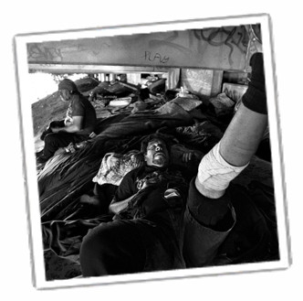
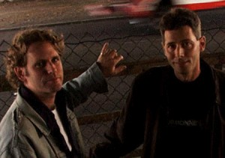
BOURGOIS Philippe, SCHONBERG Jeff, 2009, Righteous Dopefiend, University of California Press.

Slide 21
BOURGOIS Philippe, SCHONBERG Jeff, 2009, Righteous Dopefiend, University of California Press.
“This powerful anthropological and photographic study plunges the reader into the world of homelessness and drug addiction in the contemporary United States. For over a decade Philippe Bourgois and Jeff Schonberg followed two dozen heroin injectors and crack smokers in their scramble for survival on the streets of San Francisco. Righteous Dopefiend is a vivid chronicle of intimate suffering, solidarity, and betrayal and a trenchant analysis of the structural forces that shape the lives of the destitute in the world’s wealthiest nation.” (Back cover of the book)

Slide 22
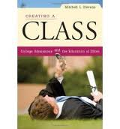
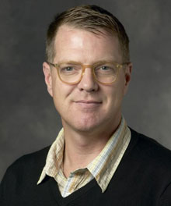
STEVENS Mitchell, 2009, Creating a Class: College Admissions and the Education of Elites. Harvard University Press.

Slide 23
STEVENS Mitchell, 2009, Creating a Class: College Admissions and the Education of Elites. Harvard University Press.
Admissions officers love students but they work for the good of the school. They must bring each class in "on budget," burnish the statistics so crucial to institutional prestige, and take care of their colleagues in the athletic department and the development office
Stevens explains how elite colleges and universities have assumed their central role in the production of the nation's most privileged classes. Creating a Class makes clear that, for better or worse, these schools now define the standards of youthful accomplishment in American culture more generally. (Back cover of the book)

Slide 24
HO Karen, 2009, Liquidated: An Ethnography of Wall Street, Duke University Press.

Slide 25
HO Karen, 2009, Liquidated: An Ethnography of Wall Street, Duke University Press.
“Financial collapses—whether of the junk bond market, the Internet bubble, or the highly leveraged housing market—are often explained as the inevitable result of market cycles: What goes up must come down. In Liquidated, Karen Ho punctures the aura of the abstract, all-powerful market to show how financial markets, and particularly booms and busts, are constructed. Through an in-depth investigation into the everyday experiences and ideologies of Wall Street investment bankers, Ho describes how a financially dominant but highly unstable market system is understood, justified, and produced through the restructuring of corporations and the larger economy.” (Back cover of the book)

Slide 26
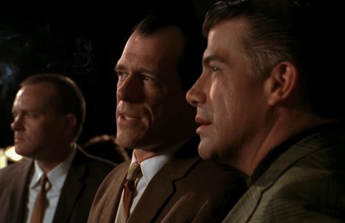
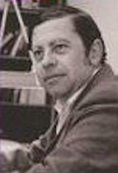
HUMPHREYS Laud, 2008 (1970), Tearoom Trade: Impersonal Sex in Public Places, Chicago, Aldline Publishing Company.

Slide 27
HUMPHREYS Laud, 2008 (1970), Tearoom Trade: Impersonal Sex in Public Places, Chicago, Aldline Publishing Company.
“From the time of its first publication, Tearoom Trade engendered controversy. It was also accorded an unusual amount of praise for a first book on a marginal, intentionally self-effacing population by a previously unknown sociologist. The book was quickly recognized as an important, imaginative, and useful contribution to our understanding of "deviant" sexual activity. Describing impersonal, anonymous sexual encounters in public restrooms—"tearooms" in the argot—the book explored the behavior of men whose closet homosexuality was kept from their families and neighbors”. (Back cover of the book)

Slide 28
ELIASOPH Nina, 1998, Avoiding Politics. How Americans Produce Apathy in Everyday Life, Cambridge University Press.

Slide 29
ELIASOPH Nina, 1998, Avoiding Politics. How Americans Produce Apathy in Everyday Life, Cambridge University Press.
“Civic groups are said to be the fount of democracy, but these vivid portraits of American life reveal an intriguing culture of political avoidance. Nina Eliasoph accompanied volunteers, activists and recreation club members, listening to them talk--and not talk--politics, in a range of private and public settings. Unlike interview-based studies of political participation and civic culture, Avoiding Politics shows how citizens create and communicate political ideas in everyday life, and the hard work it takes to produce apathy in a democracy.” (Back cover of the book)

Slide 30
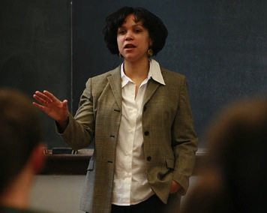
HARRIS-LACEWELL Melissa V., 2006, Barbershops, Bibles, and BET: Everyday Talk and Black Political Thought, Princeton University Press.

Slide 31
HARRIS-LACEWELL Melissa V., 2006, Barbershops, Bibles, and BET: Everyday Talk and Black Political Thought, Princeton University Press.
“Using statistical, experimental, and ethnographic methods Barbershops, Bibles, and B.E.T offers a new perspective on the way public opinion and ideologies are formed at the grassroots level. The book makes an important contribution to our understanding of black politics by shifting the focus from the influence of national elites in opinion formation to the influence of local elites and people in daily interaction with each other. Arguing that African Americans use community dialogue to jointly develop understandings of their collective political interests, Harris-Lacewell identifies four political ideologies that constitute the framework of contemporary black political thought: Black Nationalism, Black Feminism, Black Conservatism and Liberal Integrationism. These ideologies, the book posits, help African Americans to understand persistent social and economic inequality, to identify the significance of race in that inequality, and to devise strategies for overcoming it.” (Back cover of the book)

Slide 32
How to write a Book Memo?
5-7 pages long. (1500 to 2500 words).
Again, avoid plagiarism.
Due the 28th of March, 2013.
Bring a printed copy at the beginning of the class (see the handout if you’re over the deadline).
It is not a summary, take a systematic, analytical approach to the text.
See the handout for all the points you’ll go through while reading and writing.

Slide 33
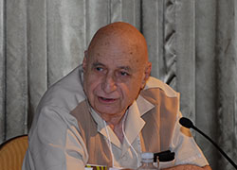
What is Sociology? (Berger, 1929, book 1963)

Slide 34
Sociology is not:
Best to start with what sociology is NOT:
Social work, “working with people”: getting them out of slums or getting them into jail, making them produce better automobiles or making them better bomber pilots.
Psychology, psychiatry.
=> “Cultural lag”
A practice in society.

Slide 35
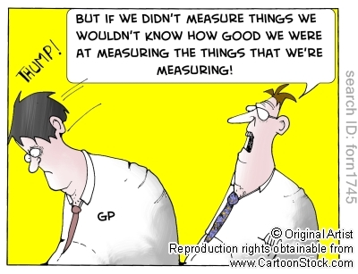
The sociologist is not:
A social reformer. Sociological understanding won’t serve as a political, military application.
A gatherer of statistics about human behavior.

Slide 36
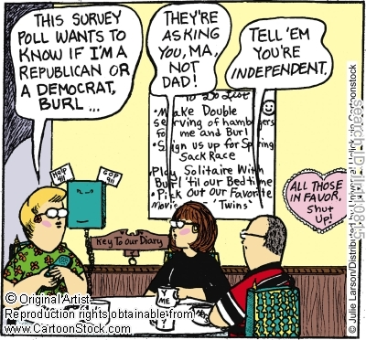
The sociologist is not(2):
A pollster:

Slide 37
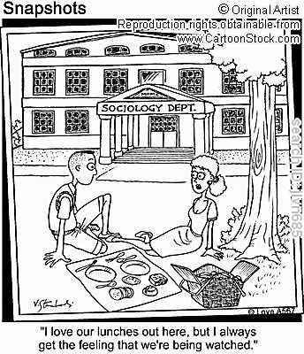
The Sociologist is not(3):
A detached, sardonic observer, and a cold manipulator of men.

Slide 38
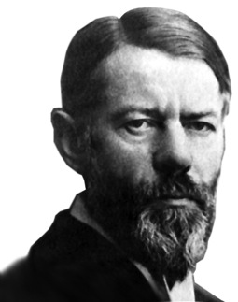
Elements of a definition
An attempt to understand. (suicide, capitalism, state, family, class, gender, etc.)
“Value-free” (Max Weber, 1864-
1920, one of the founding
architects of sociology).
One fundamental value:
Scientific integrity.
Sociology strives toward an act
of pure perception.

Slide 39
Elements of definition-2
A science (admittedly a very peculiar one, but still a science), with certain scientific canons of procedure.
The sociologist:
Understands society in a disciplined way
His/her operations are bound by certain rules of evidence
Tries to be objective, to control his/her personal preferences and prejudices, to perceive clearly
His goal is to attempt to understand society
Is endlessly interested in the doings of men: their institutions, their history, their passions
Everything is valuable: gossip, looking through keyholes, etc.

Slide 40
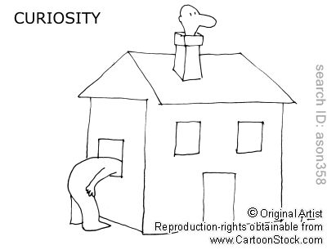
Elements of definition(3):
The sociologist is curious!

Slide 41
The classic sociologist’s questions:
“What are people doing with each other here?”
“What are their relationships to each other?”
“How are these relationships organized in institutions?”
“What are the collective ideas that move men and institutions?”

Slide 42
The excitement of sociology
A transformation of perception, and of consciousness:
“The familiar becomes transformed in its meaning”
“The fascination of sociology lies in the fact that its perspective makes us see in a new light the very world in which we have lived all our lives”
Raising new questions.
“social reality turns out to have many layers of meaning”
“things are not what they seem”.

Slide 43
Or…
Would you prefer the “world-taken-for-granted” (Schutz)?

